Slide 1
Project 1:
Apache Hive
Arif Banai • 05.19.2021

Slide 2
Overview
This project required us to load in a given dataset to Hive and answer some questions about the data.
To answer these questions, I created tables for each dataset, and some combined tables, derived from combining the datasets.

Slide 3
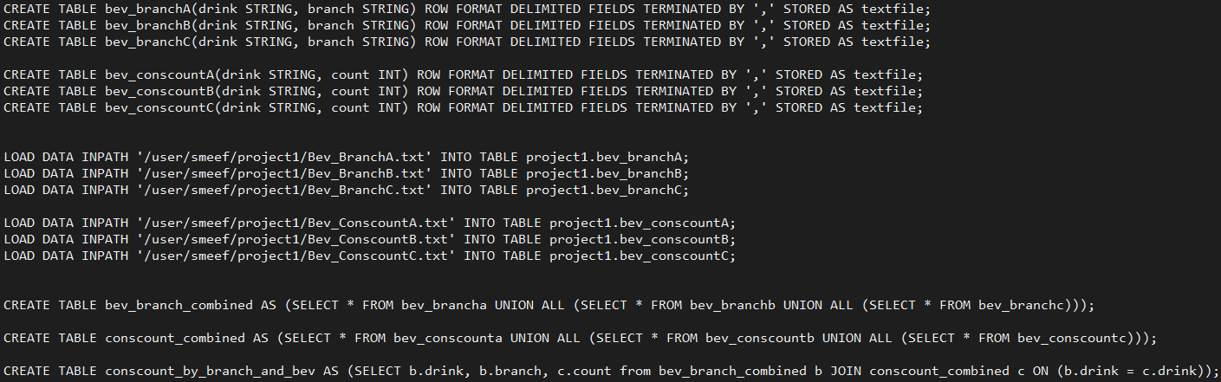
Setting up the Tables & Loading Data
These commands created the tables and loaded the data from the files in the HDFS
The three statements at the bottom were derived as they are necessary for the upcoming questions

Slide 4
Question 1 - Part 1
What is the total number of consumers for Branch 1?
Searching on the combined branch and consumer count table, we can retrieve the branch and number of consumers using the sum() aggregate function
The sum(count) function sums the count for each branch,
GROUP BY groups our results on the branch field
When using GROUP BY, the number of rows returned should be equal to the number of unique values in the grouping field
The WHERE clause is used to select only Branch1

Slide 5
Question 1 - Part 2
What is the number of consumers for Branch 2?
Same scenario as before, just filter for Branch 2 instead

Slide 6
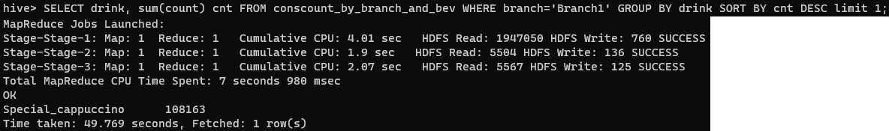
Question 2 - Part 1
What is the most consumed beverage in Branch 1?
This is similar to question 1, however…
Now we sort by the sum of the number of consumers for drinks from branch 1 (desc)
Limit our result to the top 1 (the first row)

Slide 7
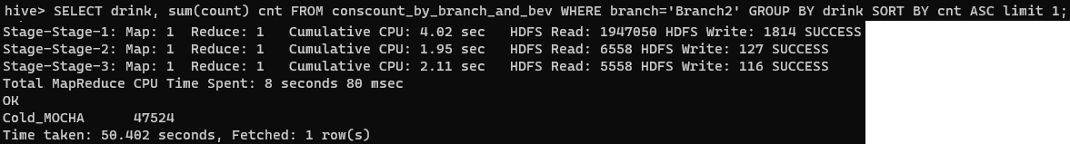
Question 2 - Part 2
What is the least consumed beverage in Branch 2?
Similar to the previous question…
But now we sort in ASC order to get the least consumed beverage

Slide 8
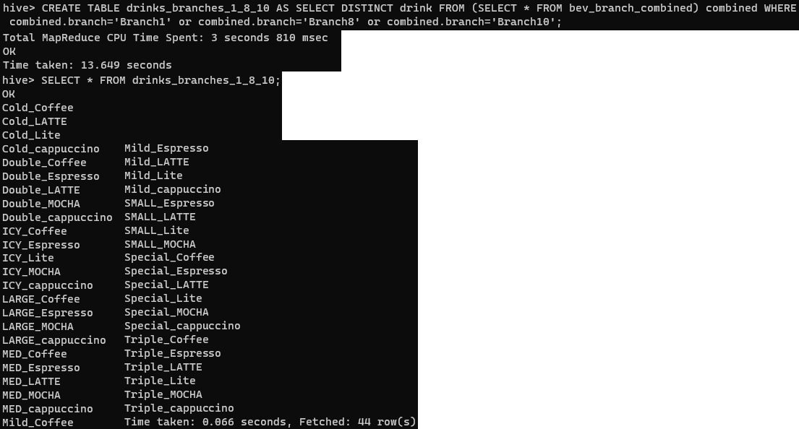
Question 3 - Part 1
What are the beverages available in Branch 1, Branch 8, and Branch 10?
We create a new table that is comprised of all DISTINCT beverages in Branch 1, 8, and 10
DISTINCT removes all duplicate values from our result

Slide 9
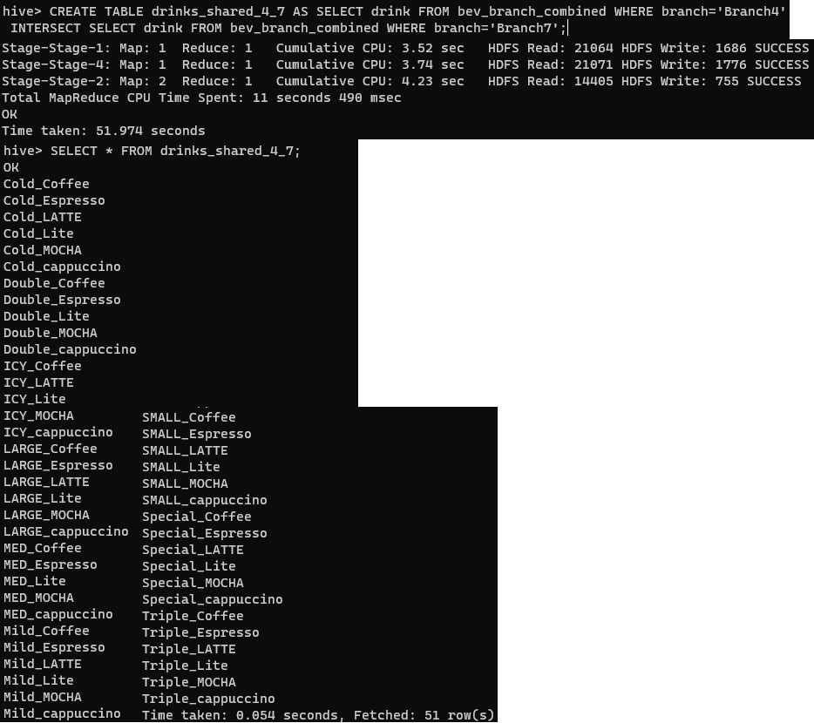
Question 3 - Part 2
What are the common beverages available in Branch 4 and Branch 7?
Similar to the previous question, we create a new table using the INTERSECT operator to show all the common drinks between branch 4 and branch 7

Slide 10
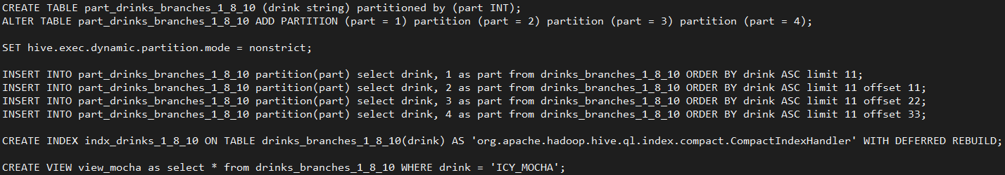
Question 4 - Part 1
Create a Partition, Index, and a View for the Problem 3
A separate partition table is created, with 4 partitions defined.
Partition mode is set to nonstrict to enable Dynamic partitioning
Allows us to insert data into the partition
Partitioning generally improves query performance, separates data on partition field
An Index allows queries using predicates like WHERE to run substantially faster
The compact index stores the column value and storage blockID
As opposed to Bitmap index, which stores column value and list of rows as a bitmap
Views are like an alias for some Query; The result is not stored and reused (vs Materialized View)
Views are Read-Only, cannot insert on a view

Slide 11
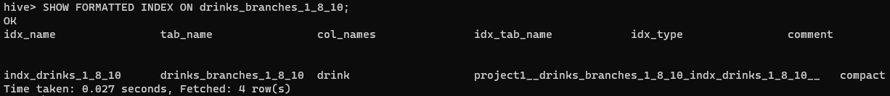
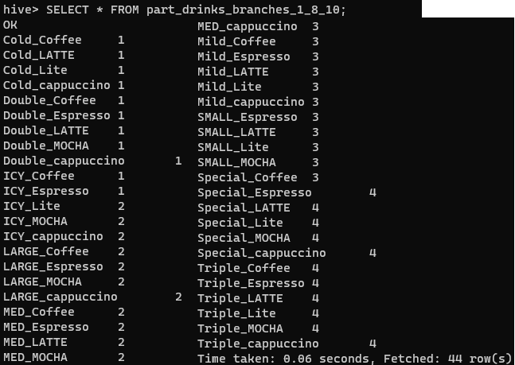
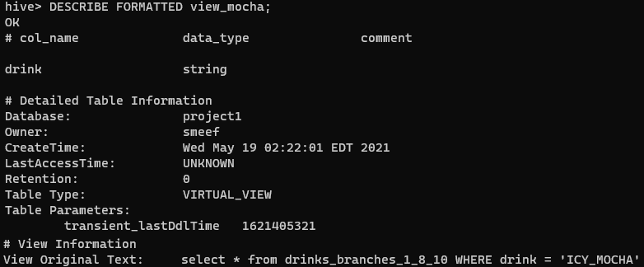
Question 4 - Part 1
Create a Partition, Index, and a View for the Problem 3

Slide 12
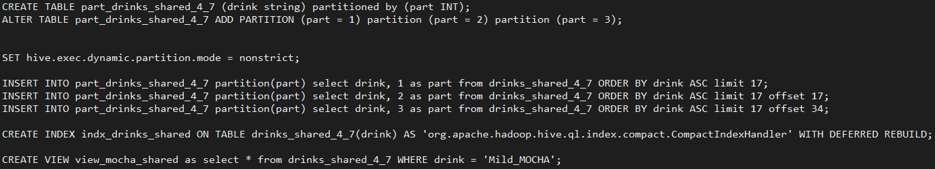
Question 4 - Part 2
Create a Partition, Index, and a View for the Problem 3
Same as Part 1, just on a different table

Slide 13
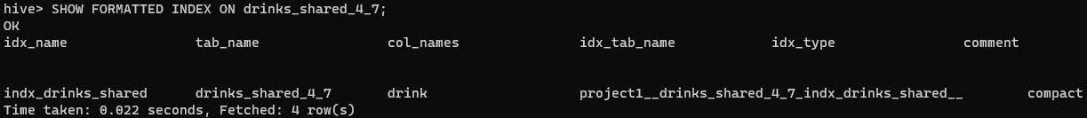
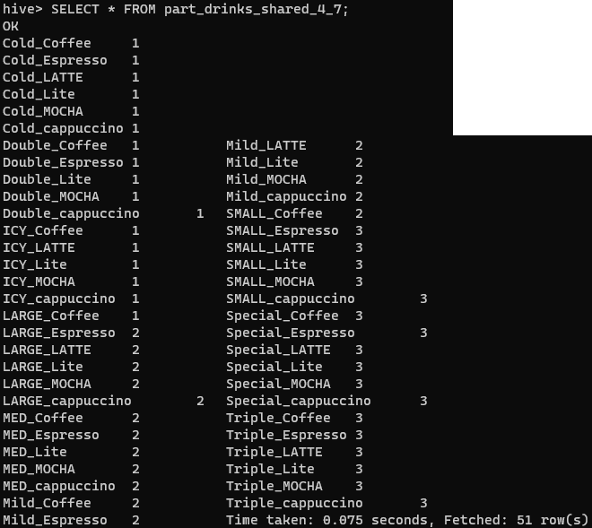
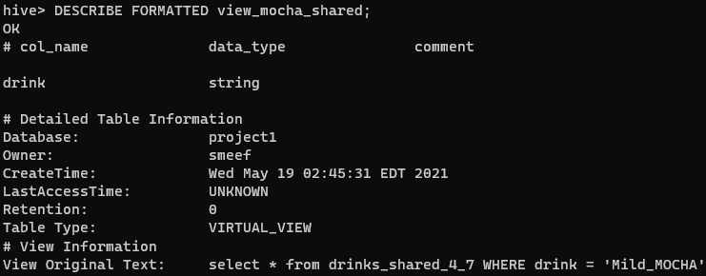
Question 4 - Part 2
Create a Partition, Index, and a View for the Problem 3

Slide 14
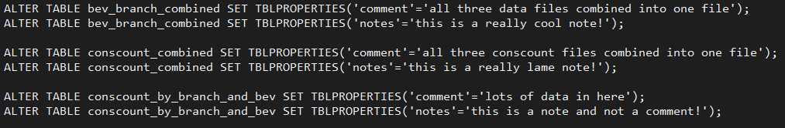
Question 5
Alter table properties to add "note" and "comment"
Table properties can be edited to further describe the table through metadata
Mainly used to help other developers understand your tables purpose and other quirks about the table and data within
The table properties can be displayed using SHOW TBLPROPERTIES [table name]

Slide 15
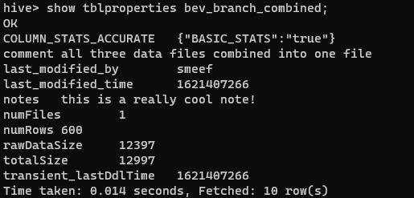
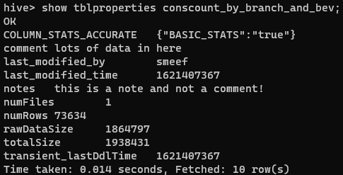
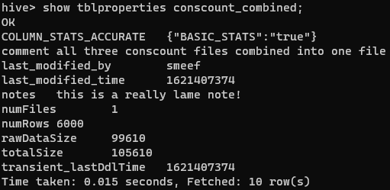
Question 5
Alter table properties to add "note" and "comment"

Slide 16
Question 6
Remove row 5 from the output of a query in Problem 1
This query utilizes ROW_NUMBER(), which adds a new column to the table
Denotes the order the rows appear in
Requires the over() function to define the ordering
We can then exclude the fifth row using a WHERE clause,
Match on the fifth row using the row_number field

Slide 17
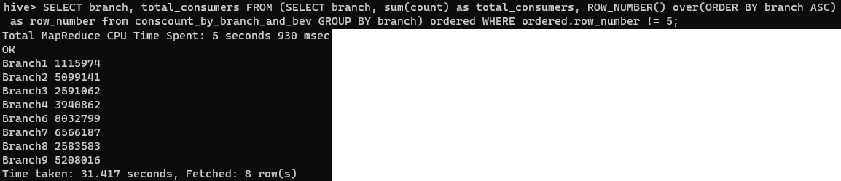
Question 6
Remove row 5 from the output of a query in Problem 1
Notice how Branch 5 is not in the result set

Slide 18
Thank you!

